Slide 1
UML Diagrams Ref: Whitten et all, Systems Analysis and Design Methods 7e. McGraw-Hill Higher Education
Mostafijur Rahman Akhond
Lecture, CSE
BRAC University

Slide 2
Key Ideas
Introduction to UML diagrams
Use case diagram
Sequence diagram
Class diagram
& Activity diagram

Slide 3
UML diagram
Stands for Unified Modeling Language
A language with notion which can be understand by all the parties involved with software
Initiated by Rational Software in 1994-95
Popular tools –
Rational Rose
Microsoft Visio
Draw.io

Slide 4
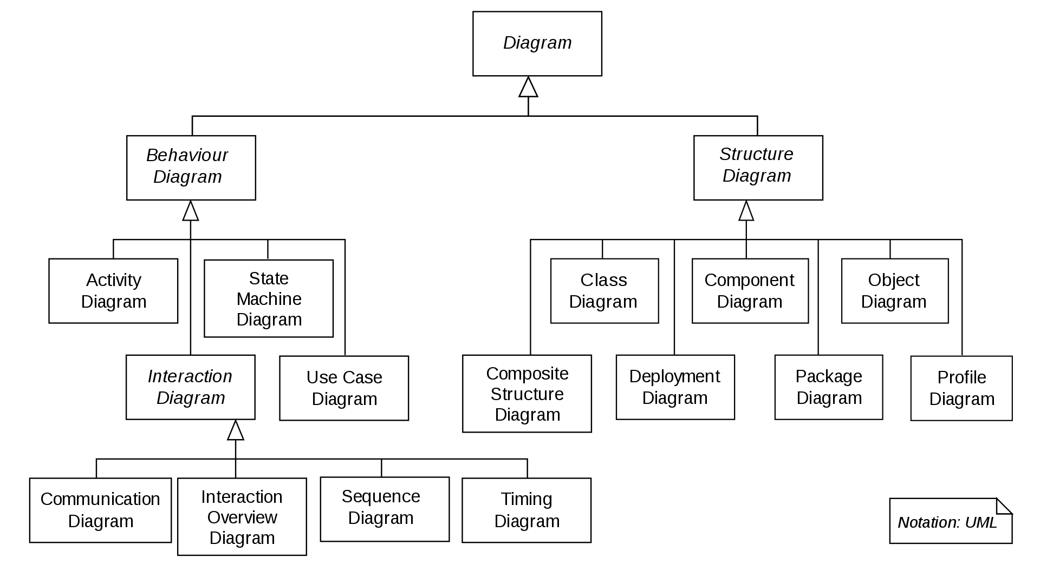
Different Types of UML

Slide 5
Use case diagram

Slide 6
What is Use Case ?
Use case diagrams considers mostly as a requirement analysis tools
It identifies the uses of the system based on a case
Use indicates the actions
Case indicates the action linked with actor (who performs the action)
All the action verbs mentioned in requirement specification is an use case in this diagram
To draw the use case diagram, one need to
Identify all the entity who will performs action
And all the actions needed to support by the system

Slide 7
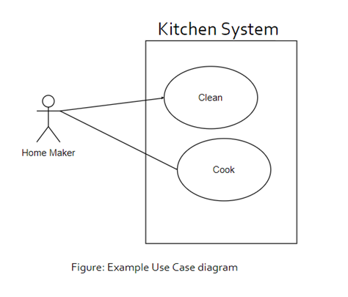
Components of Use Case diagram
Use case diagram is composed of four components
Actor
Use case
System boundary
Relations

Slide 8

Actor
The entity which performs the actions or roles in the system
Actor is responsible for giving input to the system
Responsible to use processed output for performing particular action
Actor must be connected with at least one use case
Four types of Actors can be involved in use case –
Primary actor
Secondary actor
External hardware
Other System
Figure: Actor in Usecase

Slide 9
Types of Actor
Primary actor
People who performs the main system functions.
For example rider of a ride sharing system. As s/he is requesting for ride, or paying the money using the system.
Secondary actor
People who performs the administrative functions.
For the aforementioned system a manager who sets the discounts is an example of Secondary actor.

Slide 10
Types of Actor (cont.)
External hardware
Any external hardware device which is a part of the application.
If the system using amazon datastore as their database.
Other System
Any external system which has interaction with the current system.
Payment gateway is an example of such actor.

Slide 11
Use Cases
Indicates the system functions performed by an actor
It can also describes the sequence of actions in a system
Every Use case must have a unique name
Use case must be started with principal verb
Use cases in the diagram must be enclosed by the system boundary
Every Use case should be connected with either actor or another use case
Must be represented by an ellipse
Book a ride
Figure: An Use case

Slide 12
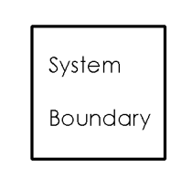
System Boundary
Shows how the system interacts with the user
Class in which use case are executed
Represented by the use cases within a rectangle and actors will outside of the system boundary
Figure: The system boundary of Use case

Slide 13
Relation
Also Known as by communication line
It represents the connection between any two components of use case diagram
Can be of three types
Association
Generalization
Dependency

Slide 14
Association
Connects an actor with the use case
Identifies the actor(s) are responsible/user of the use case
Represented by a straight solid line
No arrow
Not dashed or curved line
A actor must have at least one association in the diagram
An use case can be associated with zero or more actors
Book a ride
Rider
Figure: association between an actor and an use case

Slide 15
Generalization
Represents the parent-child relation
Represented by a straight line with hollow arrow
Can indicate the relation between
Either Actors
Or Use cases
Rider
Premium Rider
Irregular Rider
Figure: Generalization relation between actors
pay online
pay with card
pay with bkash
Figure: Generalization relation between use cases

Slide 16
Dependency
Indicates the dependency relationship between two use cases.
Two types of dependencies : Include & Extend
Include relationships
One use case (base) includes the functionality of another (inclusion case)
Supports re-use of functionality
Extend relationships
One use case (extension) extends the behavior of another (base)
Book a ride
<<include>>
Confirm the ride
Figure: Include relation
Finish the ride
<<extend>>
Get review
Figure: extend relation

Slide 17
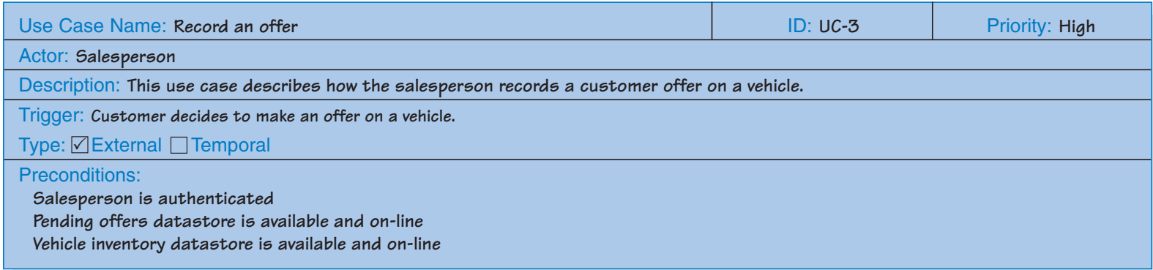
Use case Description
Every use case diagram must have its description
Usually description is presented in tabular form
The diagram should have a unique id
Typically the description form include the fields –
Use case Name, Id, Actor(s), Description, Precondition, Postcondition, Action Flow, Exceptions, etc.
All the fields might not be available for all the diagrams.
Figure: An Use case description table

Slide 18
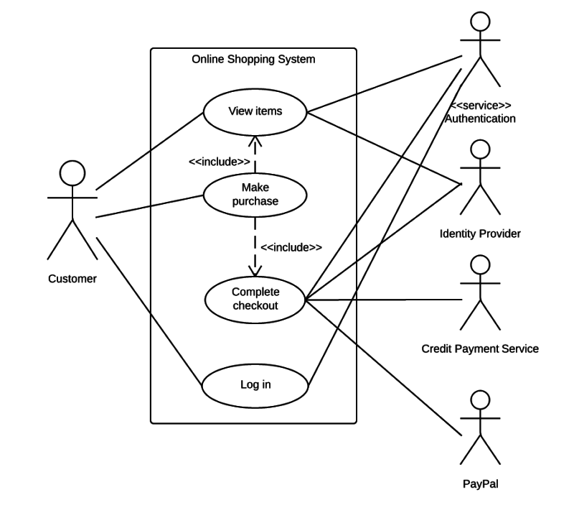
Use case example 1 : Purchasing an item

Slide 19
Class diagram

Slide 20
What is class diagram
A class diagram depicts classes and their interrelationships
Used for describing structure and behavior in the use cases
Provide a conceptual model of the system in terms of objects and their relationships
Used for requirement capture, end-user interaction
Detailed class diagrams are used for developers

Slide 21
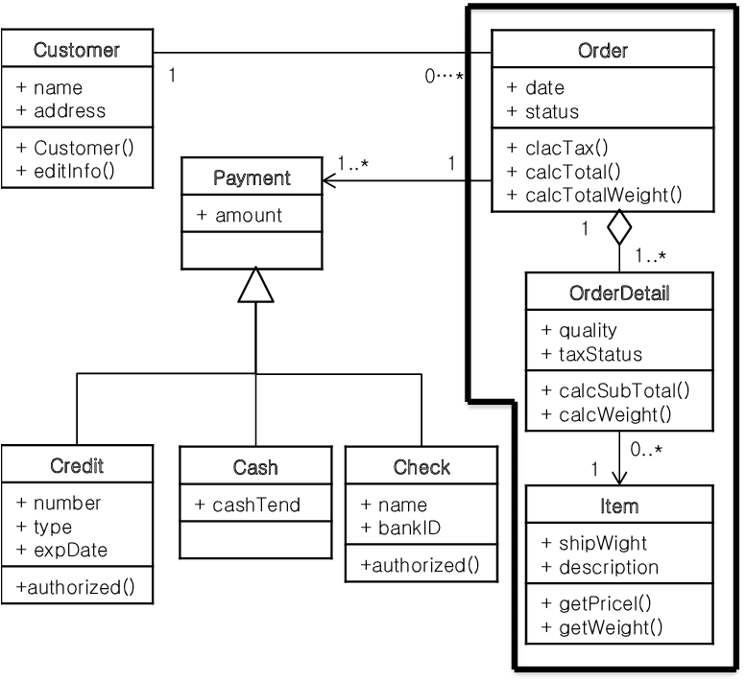
Class Diagram components
Class
Name
Attributes
Methods
Visibility
Relation
Generalization
Association
Aggregation
Composition
Multiplicity
Figure: Class diagram

Slide 22
Class
Class in a class diagram contains three parts – top, middle and bottom
Top
contains the name of the class. It is printed in bold and centered, and the first letter is capitalized.
Middle
middle compartment contains the attributes of the class. They are left-aligned and the first letter is lowercase.
Bottom
bottom compartment contains the operations the class can execute. They are also left-aligned and the first letter is lowercase.

Slide 23
Visibility
Public (+)
Private (-)
Protected (#)
Package (~)
Derived (/)
For example age is a derived attribute from date of birth
Static (underlined)

Slide 24
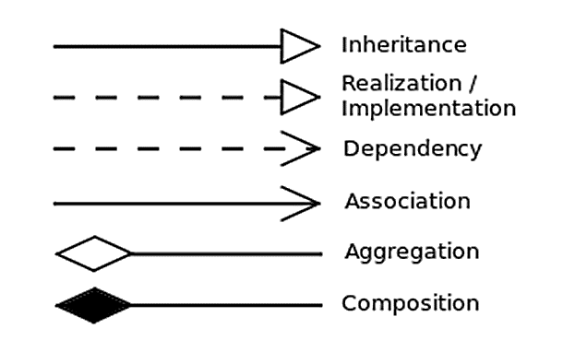
Relation notions in class diagram

Slide 25
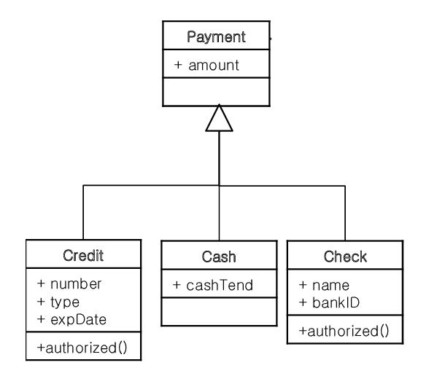
Generalization
Inheritance is a required feature of Object Orientation Programming
Generalization expresses a parent/child relationship among related classes.
Used for abstracting details in several layers
Similar notion as use case diagram
Figure: Generalization in class diagram

Slide 26
Association
Represent relationships between classes.
Place association names above, on, or below the association line.
Represent relationship between instances of classes
Student enrolls in a course
Courses have students
Courses have exams
Association has two ends
Role names (e.g. enrolls)
Multiplicity (e.g. One course can have many students)
Navigability (unidirectional, bidirectional)
Enrollment
Student
*
4
Course
has
enrolls
Figure: Association in class diagram

Slide 27

Aggregation
Represents “has a" relationship between classes.
Aggregation is a directional relationship
The hollow rectangle indicates the master in the relation
When the container is destroyed, the contents are usually not destroyed
For example - a professor has students, when the professor dies the students don't die along with him or her.

Slide 28

Composition
Denotes a strong ownership between two classes
Composition is also a directional relationship
The filled rectangle indicates the master in the relation
When the container is destroyed, the contents are also destroyed
For example – an IC has transistors, when the IC is dumped the transistors are also dumped with the circuit.

Slide 29
Multiplicity
Notion | Meaning
0 | No instances (rare)
0..1 | No or One instance
1 | Exactly one instance
1..1 | Exactly one instance
0..* | Zero or More instances
* | Zero or More instances
1..* | One or More instances

Slide 30
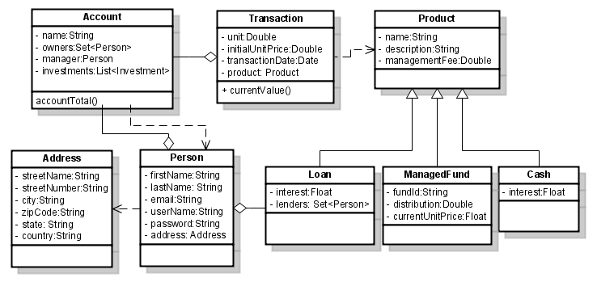
Example Diagram

Slide 31
How to draw the Class diagram
Identify all the objects from the requirement
The proper nouns from the requirement becomes the class usually
Identify the hierarchy between the classes (if any) based on the common attributes and functions
Identify all the relations
The “has” in requirements usually maps as relational in class diagram
After finding the classes/objects and relations- draw the diagram structure

